Slide 1
Saving the Hanne Frank A Danish Fishing Boat in Houston

Slide 2
9 April 1940, Germany invades Denmark
Notes:
The story begins on 9 April 1940, when, in a combined attack against Norway, Germany invaded Denmark. Within hours of the invasion, Denmark surrendered and accepted the occupation. It retained its neutrality, its monarchy, and its constitution while under German occupation.

Slide 3
Denmark’s King Christian X resisted implementation of the “Final Solution” in Denmark.
Notes:
Denmark’s King Christian X resisted Nazi efforts to implement the “Final Solution,” in Denmark, threatening to abdicate if occupation forces implemented anti-Jewish laws. The resistance of the Danish government continued until August 1943, when the Nazis initiated martial law.

Slide 4
Strikes and riots at Odense shipyard and the bombing of Forum Hall in Copenhagen led to martial law in August 1943.
Notes:
That action resulted after dockworkers refused to repair German ships at the Odense shipyard. Danish resistance fighters then blew up the German-occupied Forum Hall in Copenhagen. The following day, 25 August 1943, all Danish shipyards went on strike. Martial law was initiated on 29 August 1943. With the force of martial law, the Nazis were able to overcome resistance to their plans to identify, round up and deport Danish Jews.

Slide 5
The Danish population of about 8,000 Jews was to be rounded up and loaded onto a ship for deportation to Theriesenstadt, a concentration camp in Czechoslovakia.
Notes:
By September 1943, occupation forces had geared up a plan to deport the Danish Jews to concentration camps. They planned to round them up on 1 October 1943 and load them onto ships that had been brought to the harbor in Copenhagen for deportation to Theriesenstadt, a concentration camp in Czechoslovakia.

Slide 6
On the night of the roundup, 1 October 1943, only 284 Jews were arrested, of whom 50 were let go and only 202 were led onto the Wartheland. Arrests over the next several days brought the total to 477.
Notes:
German maritime attaché Georg F. Duckwitz leaked German plans to round up the Jews to Danish politicians. On 29 September, Chief Rabbi Melchior announced the news in the synagogue and urged all members of the congregation to hide and flee. The news spread like wildfire through friends, business acquaintances, and strangers wanting to help. Ordinary citizens all over the country offered refuge in churches, attics, country homes, and residences. Complete strangers walked up to Jews on the street to offer keys to their apartments. Medical staff hid more than 1,000 Jews in Copenhagen hospitals.

Slide 7
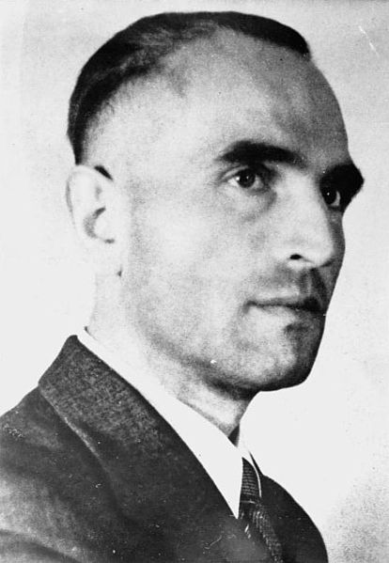
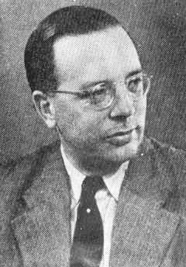
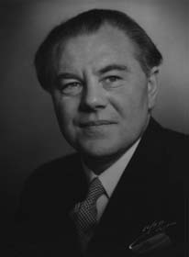
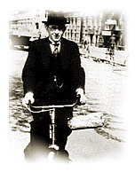
SS Obergruppenführer
Dr. Werner Best
German Maritime Attache
George F. Duckwitz
Social Democrat
Hans Hedtoft
Acting Chief Rabbi
Marcus Melchior
Notes:
To answer that question, I must introduce you to the four key players who affected the destiny of the Danish Jews. SS Oberruppenfuhrer Dr. Werner Best was assigned the task of rounding up the Jews and sending them to Theriesenstadt. When Best briefed his staff, his Maritime Attache George Duckwitz leaked the plan to Hans Hedtoft, a member of the Danish government. Hedtoft then told Chief Rabbi Marcus Melchior, who warned his congregation and sent them into hiding.

Slide 8
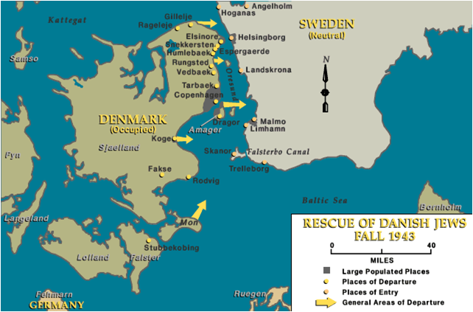
Boats evacuated refugees across the Oresund strait between Zealand and Sweden .
Notes:
Fishermen took groups of from 5 to 10 people, hidden in the fish holds of their fishing boats across the narrow straights to Sweden. Some of the fishermen assisting in the rescue charged money, while others took payments only from those who could afford passage. The Danish underground movement quickly stepped in and took an active role in organizing the rescue and providing financing, mostly from wealthy Danes who donated large sums of money for the rescue.

Slide 9
The Danish fishing fleet smuggled over 7,200 Jews to Sweden. That was 90% of the total Jewish population in Denmark.
Notes:
Between 26 September and 12 October 1943, the members of the Danish fishing fleet smuggled more than 7,200 Jews into Sweden, where they lived out the remainder of the war in relative safety.

Slide 10
Escapees were hidden in the holds under nets and tarpaulins to prevent discovery.
Notes:
Once aboard, escapees were hidden in the fish holds under nets and tarpaulins in case the boat was boarded by coastal patrols. Inspectors were shown the center hold, which on these boats held sea water as ballast, to give the impression the boat was empty. Only five to ten passengers could be hidden on each trip. These fishing boats made more than 700 such trips to Sweden during a span of less than three weeks.

Slide 11
In 2006, the Holocaust Museum conducted a diligent search
and located a fishing boat in Gilleleje, Denmark.
Notes:
In 2001, after viewing a traveling exhibit depicting the rescue of the Danish Jews, Pete and Charlotte Berkowitz, of Houston, visited Gilleleje and toured the church, waterfront and the library, where archives of the exodus are kept. In 2003, the Holocaust Museum Houston honored Denmark with its LBJ Moral Courage Award, thereby developing a lasting relationship with the leadership of that country. That year, Museum Executive Director Susan Llanes-Myers began a search for a Danish fishing boat for permanent display at the museum. In 2006, her quest finally took her to Jan Ferdinandsen, a boat broker in Gilleleje, who helped her to find a suitable fishing boat. He was motivated to help in this search because members of his family had participated in helping Jews to escape to Sweden.

Slide 12
A Danish shipyard refurbished the boat before shipping it to Houston.
Notes:
Ferdinandsen restored and repainted the boat, installing a new wheelhouse and decking over the engine room before it was transported to Houston by Maersk shipping lines.

Slide 13
The boat was placed next to the railcar exhibit at the museum.
Notes:
In November 2007, the boat was lowered onto its concrete base next to the railcar exhibit at the museum, thereby placing two modes of transportation in sharp contrast; the railcar a symbol of oppression and the boat a symbol of freedom resulting from individual efforts to resist oppression.

Slide 14
The Hanne Frank is built of Danish Oak. She is 37’1” long, has a beam of 13’10”, a draft of 5’9” and weighs about 13 tons (net).
Notes:
The Hanne Frank is built of Danish oak and is 36’ long, has a beam of 13’6”, a draft of 5’6” and has a registered gross weight of 13.37 tons.

Slide 15
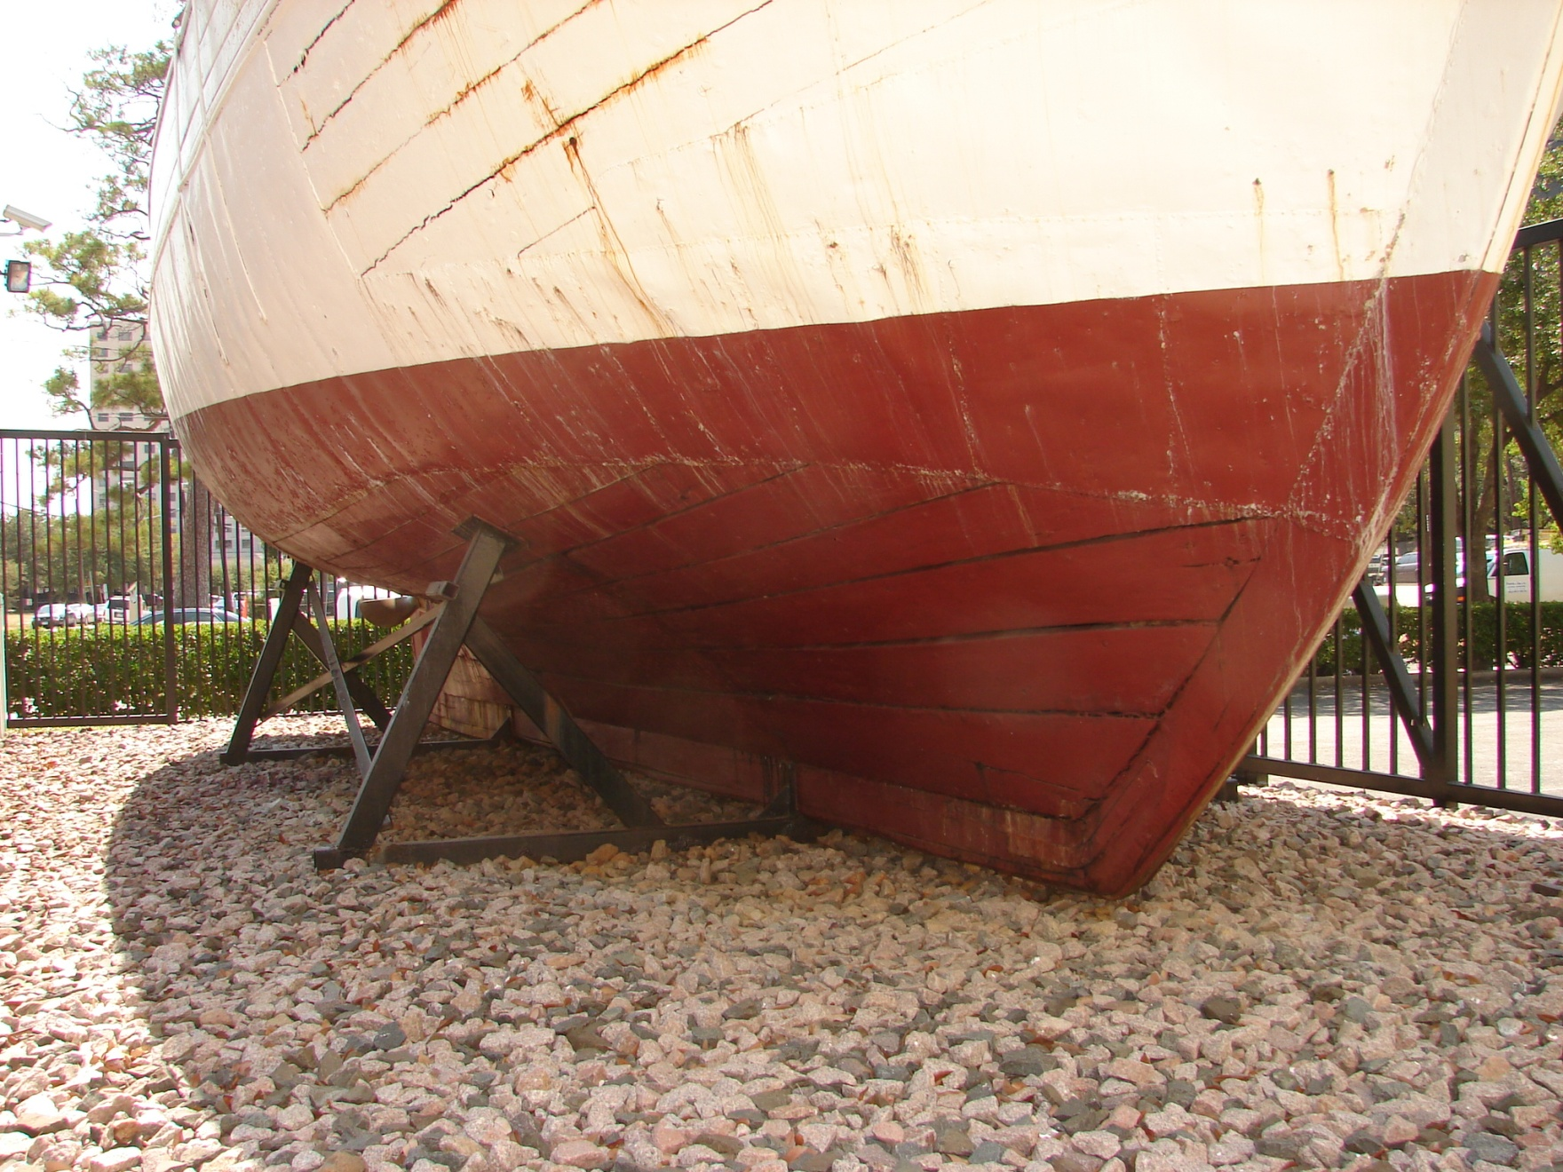
By 2011, the keel had warped or “hogged,” which caused separation of hull planks.

Slide 16
The center hold, or “pond” allows sea water to enter through holes in the hull. This is where fish were stored while the crew was actively fishing. These planks were rotted and had to be replaced.

Slide 17
Deck beams and carlins had rotted at the ends.
Notes:
A close inspection showed that deck problems resulted because deck beams and carlins had begun to rot at the ends, thereby weakening the deck structure.

Slide 18
Decking was rotted and had sprung in some areas.
Notes:
Deck planking is rotted in some areas and some decking has sprung.

Slide 19
The Goal
Photo @ 1970 following a restoration by then owner A. A. Finne

Slide 20
Original Launch Photo

Slide 21
Restoration Process
Researched and documented original information about the boat
Researched the history of the boat and the rescue effort
Notes:
The development of a thorough history of the boat and the rescue effort will enhance the value of the exhibit. Thorough research of the boat, its ownership, maintenance history and activities needs to be conducted.
The boat currently sits somewhat aloof from the viewing area that provides access to the railcar nearby. The Museum is considering the construction of a “dock” next to the boat to allow visitors (and maintenance crews) to get closer to the boat.

Slide 22
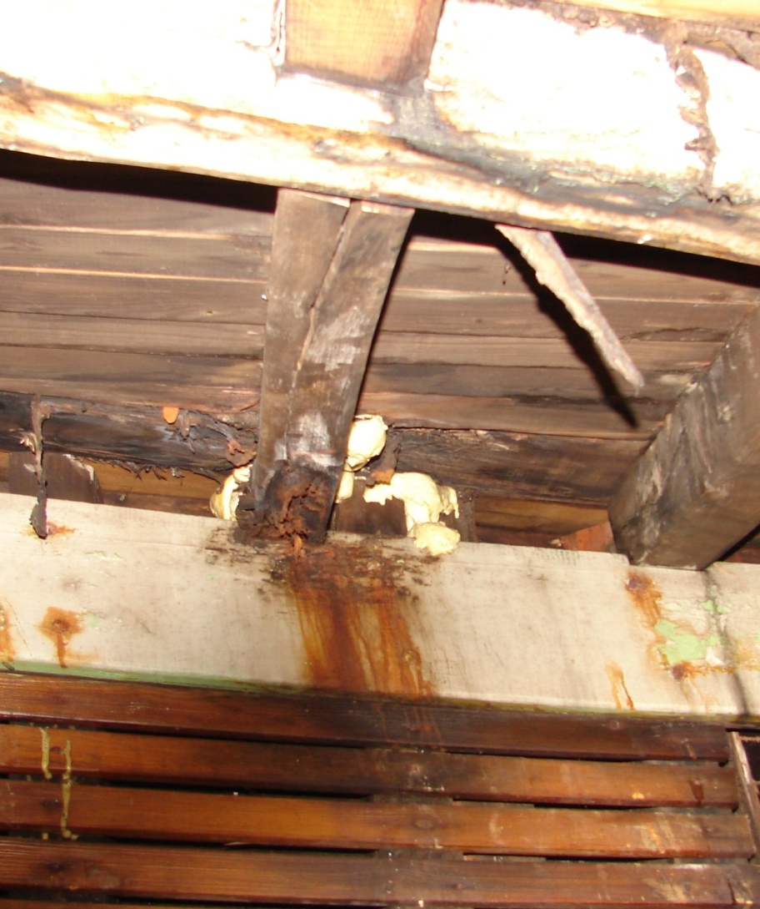
Restoration Process
Removed items not original to the boat (engine, gas tanks, pilot house, doghouse)
Improved ventilation
Made detailed measurements and prepared detailed drawings
Reset the keel at a water line level attitude.
Protected the boat against the elements
Replaced rotted beams, planks and decking
Rebuilt the wheel house and fore cabin
Notes:
Following an inspection by Museum Conservator Brian Howard, a restoration plan was developed that included a number of steps.

Slide 23
Debris Removal
Items were removed, measured, photographed, and tagged

Slide 24
Measurement Project
Dr. David Stewart, ECU, assisted by museum volunteers, used a Total Station to measure the boat..

Slide 25
Measurement Project
ECU team members meticulously recorded thousands of data points

Slide 26
Measurement Project
Total Station points were recorded manually and electronically

Slide 27
Measurement Project
Each component of the boat was also measured by hand for reference

Slide 28
Measurement Project
Measurement data was used to develop lines drawings.

Slide 29
Measurement Project
Connecting data points created a 3-D image of the boat and each of its components

Slide 30
Cradle Design
The 3-D image was used to design a new cradle for the boat.

Slide 31
Cradle Design
The new cradle was built and donated by SwiftShips Inc.

Slide 32
Demolition
Wheelhouse, masts, engine deck, and decking were all removed.

Slide 33
Demolition
Pig iron ballast in stern was removed and scrapped.

Slide 34
Demolition
The engine and fuel tanks were removed and scrapped.

Slide 35
Demolition
Rotted and damaged frames, beams and decking were removed.

Slide 36
Demolition
Metal sheathing on the hull was removed and scrapped.

Slide 37
A cover and a hoist were installed

Slide 38
Paint was stripped from the hull using walnut shell pellets.

Slide 39
All nail heads were primed with epoxy primer, holes, cracks and voids were filled with epoxy filler, caulk, or seaming compound. Jotun Paint Co. donated all the paint and helped apply it.
.

Slide 40
Holes were plugged with matching wood plugs
.

Slide 41
Damaged, split and broken planks were repaired.

Slide 42
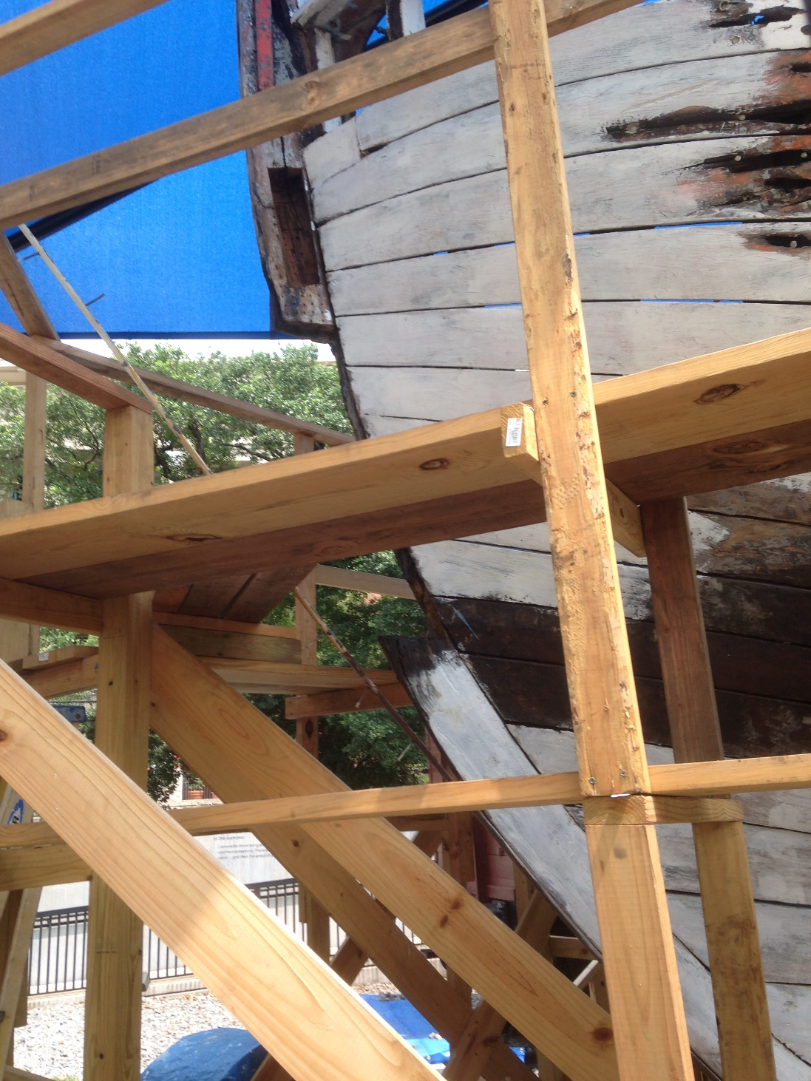
An entire section of the stem had to be replaced.

Slide 43
Completed stem repair.

Slide 44
All decking and deck beams were replaced.

Slide 45
We replaced center hold (pond) bulkheads and deck beams.

Slide 46
Rotted hull planks were duplicated and replaced.

Slide 47
We repaired and restored both masts and installed new oak cleats.

Slide 48
We removed and replaced or repaired all railing stanchions.

Slide 49
After repairing all railing stanchions we installed new oak margin planks.

Slide 50
We fabricated new hatch covers, laid a new yellow pine deck, and installed new oak forward cabin bulkheads.

Slide 51
We outfitted the new forward cabin with a new ladder, interior bulkheads, seats and decking.

Slide 52
Then we built a new wheel house.

Slide 53
We re-installed the railing planks.

Slide 54
And primed and painted the hull.

Slide 55
Moved the boat to make way for a new building

Slide 56
A commemorative name plaque was carved and mounted on the wheel house.

Slide 57
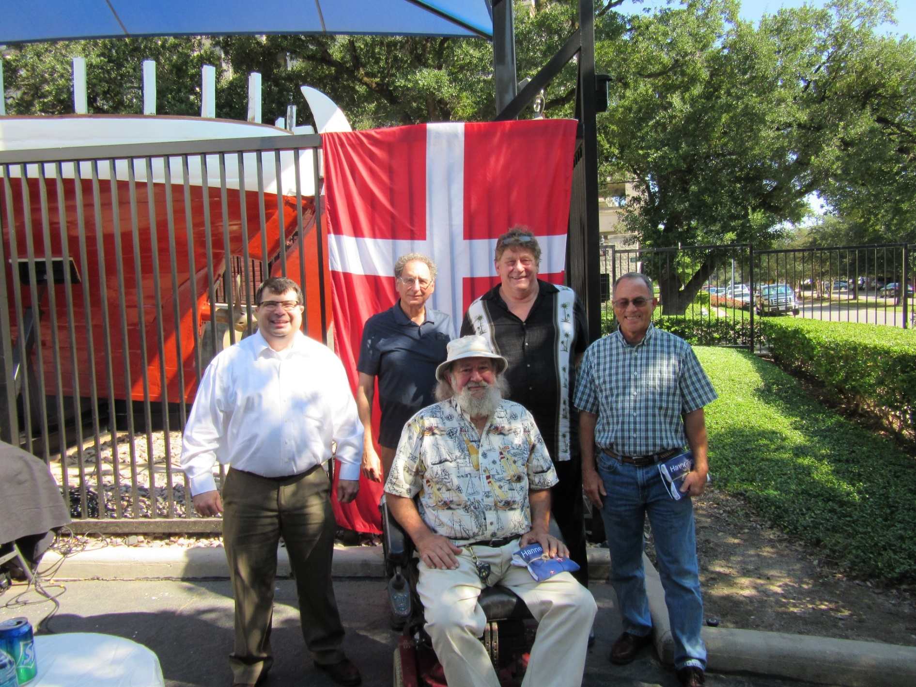
Some of the volunteers, who attended the boat rededication in 2015, included (l to r) Dan Warren, Ed Rubenstein, Joe Babcock, John Gay, and Raleigh Murbach.

Slide 58
The boat has been moved into a new building with the German rail car and is in the process of being prepared for the grand opening of the new and expanded museum in June 2019.

Slide 59
Notes:
Good Evening!
I have a wonderful story to tell you about the heroic acts of ordinary individuals who risked their own safety to rescue thousands of their countrymen during the Second World War. It is also the story of the boat you see here and the heroic efforts of many other individuals to find it and place it in the permanent collection at the Holocaust Museum of Houston. Finally, it is a story of our current efforts to rescue this boat by restoring it to its original condition and present it as a fitting icon representing the power of individuals to overcome oppression.

